Slide 1
Oracle Cloud Migration Methods
HariPrasath Rajaram

Slide 2
Agenda
Introduction
Migrating Oracle Databases to Database Cloud Service

Slide 3
Introduction
Cloud Computing Platforms
Microsoft Azure
Google Cloud Platform
Amazon Web Services
Atlantic.net
IBM Cloud
Rackspace
GoDaddy
Verizon Cloud
Oracle Cloud
DigitalOcean
VMware

Slide 4
Introduction
Private Cloud
private cloud offering is based on the exact same technology as its customer data centers, a configuration the company commonly refers to as “Engineered Systems”, which includes Linux or Solaris operating systems and VM, storage and compute resources from Exadata / Exalogic / Exalytics, all of which is linked with InfiniBand.
Public Cloud
Public clouds are commercially available, offsite solutions for hosting service models like IaaS, PaaS and SaaS over virtual networks. Public cloud providers like Oracle ,Amazon Web Services and Microsoft Azure own and operate their infrastructures at large data centers, which are then accessed over the internet by their clients.

Slide 5
Introduction
Choosing a Migration Method
You can migrate your on-premises Oracle Database database to an
Oracle Database Cloud database using a number of different methods
that use several different tools.Not all migration methods apply to all migration
scenarios. Many of the migration methods apply only if specific characteristics of
the source and destination databases match or are compatible. Moreover, additional
factors can affect which method you choose for your migration from among the
methods that are technically applicable to your migration scenario.
Some of the characteristics and factors to consider when choosing a
migration method are:
On-premises database version
Oracle Database Cloud database version
On-premises host operating system and version

Slide 6
Introduction
On-premises database character set
Quantity of data, including indexes
Data types used in the on-premises database
Storage for data staging
Acceptable length of system outage
Network bandwidth
Database version of your on-premises database:
Oracle Database 11g Release 2 version lower than 11.2.0.3
Oracle Database 11g Release 2 version 11.2.0.3 or higher
Oracle Database 12c Release 1 version lower than 12.1.0.2
Oracle Database 12c Release 1 version 12.1.0.2 or higher

Slide 7
Migration/Upgrade Methods

Slide 8
Migration/Upgrade Methods
Important factors
– Source/target version
– Source/target platform
– Downtime requirements
– Source database architecture
– Desire to adopt new features

Slide 9
Migrate Using Backup/Restore
When to use | Migration Process
No cross-endian | Backup to Oracle Database Backup Cloud Service
No structural changes | Instantiate new cloud instance from backup
No upgrade to new version
Source version 11.2.0.4, 12.1.0.2,12.2.0.1

Slide 10
Migrate Using Data Guard
When to use | Migration Process
No cross-endian | Backup to Oracle Database Backup Cloud Service
No structural changes | Instantiate new cloud instance from backup
No upgrade to new version | Configure network connection
Minimal downtime migration | Synchronize on-premises to standby
Source version 11.2.0.4, 12.1.0.2,12.2.0.1 | Switchover

Slide 11
Migrate Using Pluggable Databases (1): Unplug/Plug
When to use | Migration Process (Using file copies)
No cross-endian | Create cloud instance
Source version 12.1.0.2, 12.2.0.1 | Unplug PDB on-premises
No structural changes | Copy files to cloud
Source must be a PDB | Plug into cloud database
 | Upgrade if moving to new version

Slide 12
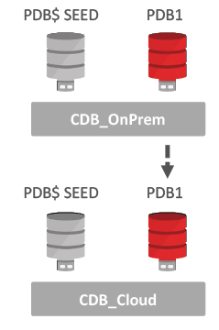
Migrate Using Pluggable Databases (1): Unplug/Plug

Slide 13
Migrate Using Pluggable Databases (2): Remote Cloning
When to use | Migration Process (Using DBMS_FILE_TRANSFER)
No cross-endian | Create cloud instance
Source version 12.1.0.2, 12.2.0.1 | Create dblink from cloud to on premises database
No structural changes | Clone PDB via dblink
Source must be a PDB | Upgrade if moving to new version
Minimal downtime with hot clone
With a source version of 12.2 this becomes hot cloning!

Slide 14
Migrate Using Pluggable Databases (2): Remote Cloning

Slide 15
Migrate Using Pluggable Databases (3): Clone a Non-CDB
When to use | Migration Process
No cross-endian | Create cloud instance
Source version 12.1.0.2, 12.2.0.1 | Create dblink from cloud CDB to on-premises non-CDB
No structural changes | Clone non-CDB over dblink
Migrate from non-CDB to PDB | Convert non-CDB to PDB by running noncdb_to_pdb.sql
No upgrade to new version
With a source version of 12.2 this also becomes hot cloning!

Slide 16
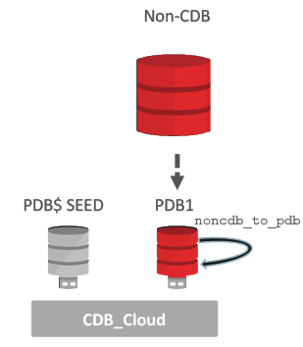
Migrate Using Pluggable Databases (3): Clone a Non-CDB

Slide 17
Upgrade/Migrate Using Data Pump
When to use | Migration Process
Cross-endian possible | Changes to database structure possible
Source version 10g and later | Export using expdp
Migrate from non-CDB to PDB | Copy dumpfiles to cloud
Changes to database structure possible | Import using impdp
Changes to database structure possible
Note: For 9i and earlier source use exp/imp

Slide 18
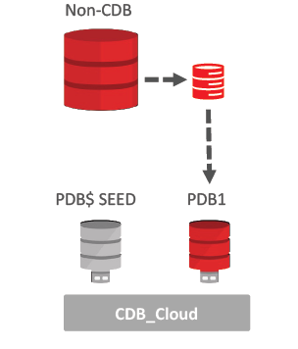
Upgrade/Migrate Using Data Pump

Slide 19
Upgrade/Migrate Using Full Transportable Export/Import
When to use | Migration Process
Cross-endian possible | Create cloud instance and PDB
Source version 11.2.0.3 and later | Export with expdp
Migrate from non-CDB to PDB | Move data files and metadata to cloud
No changes to database structure | RMAN CONVERT data files if needed
Upgrade to new version possible | Import with impdp

Slide 20
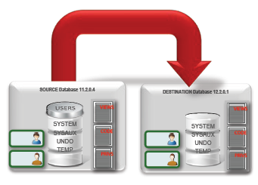
Upgrade/Migrate Using Full Transportable Export/Import

Slide 21
Upgrade/Migrate Using GoldenGate Cloud Service
When to use | Migration Process
Cross-endian possible | Create cloud instance and PDB
Source version 8i and later | Configure GoldenGate cloud service
Migrate from non-CDB to PDB | Migrate using another method (data pump, TTS, etc.)
Changes to database structure possible | Synchronize changes
Minimal downtime migration | Switch clients to cloud database
Upgrade to new version possible

Slide 22
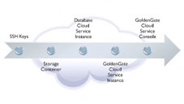
Upgrade/Migrate Using GoldenGate Cloud Service

Slide 23
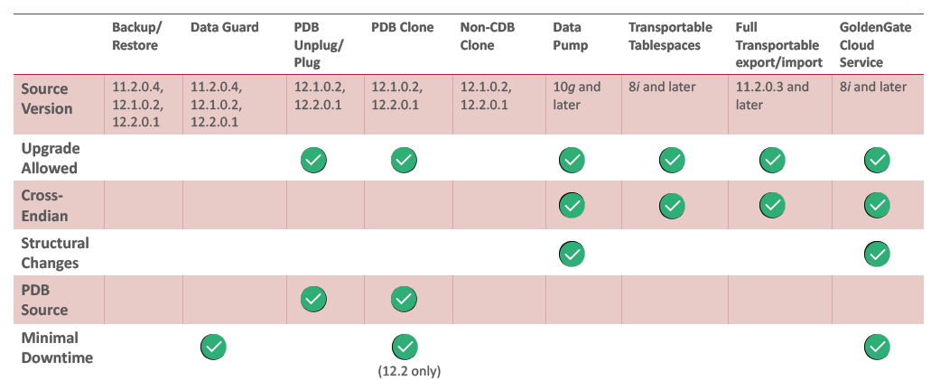
Choose the Right Migration Method

