Slide 1
Oracle Database 18c New Features
Hariprasath Rajaram

Slide 2
Training Objective
Oracle Cloud Free Account
18c Database Creation
18c Dataguard
MEMOPTIMIZE_POOL_SIZE in SGA
Cancel SQL Instead of Killing Session
Pre-Upgrade Utility (Doc ID 884522.1)
SQLPLUS New Options
18c merge partition online
Container Database
Docker Support

Slide 3
Cancel SQL Instead of Killing Session

Slide 4
SQL statement without using Resource Manager techniques
Oracle 18c is really Oracle 12.2.0.2
Step:1
Step:2
SQL> select distinct sid from v$mystat;
SID
----------
285
Step:3
SQL> begin loop null; end loop; end;
2 /
SQL> select banner_full from v$version;
BANNER_FULL
--------------------------------------------------------------------------------
Oracle Database 18c Enterprise Edition Release 18.0.0.0.0 – Production Version 18.1.0.0.0

Slide 5
SQL statement without using Resource Manager techniques
SQL> select sql_text,sql_id from v$sql where sql_text like '%loop null; end loop%';
SQL_TEXT SQL_ID
-------------
begin loop null; end loop; end;
8gadd3yhtd150
SQL> select serial# from v$session where sid=285;
SERIAL#
----------
27839
SQL> alter system cancel sql '285,27839,8gadd3yhtd150';
System altered.

Slide 6
SQL statement without using Resource Manager techniques
begin loop null; end loop; end;
*
ERROR at line 1:
ORA-01013: user requested cancel of current operation

Slide 7
Pre-Upgrade Utility (Doc ID 884522.1)

Slide 8
Pre-Upgrade Utility
Origin of Script
The pre-upgrade scripts that are available for download below are shipped with each Oracle Database release. The scripts can also be found in the newly installed $ORACLE_HOME/rdbms/admin directory of the version you are planning to upgrade to. Getting a hold of the pre-upgrade script used to mean downloading the entire Oracle Database Release kit, unpacking it, and pulling it out of the admin directory. Allowing access to the script through this method will make the Oracle Database Upgrade planning easier.
Script Guidelines
The pre-upgrade scripts can be executed on a database without the need to shutdown or restart the database. It gathers information about the database configuration and reports on conditions, parameters and settings which may need attention prior to upgrading to the new version. You must have DBA privilege to execute the script successfully. The Database can not be in read-only mode. A few registry$ tables may be created, if they do not already exist, and some rows may be inserted into existing Upgrade tables.
You must remember that this is a newer version than the one you have in your oracle home, so you need to backup the older version and replace the files from this MOS note.

Slide 9
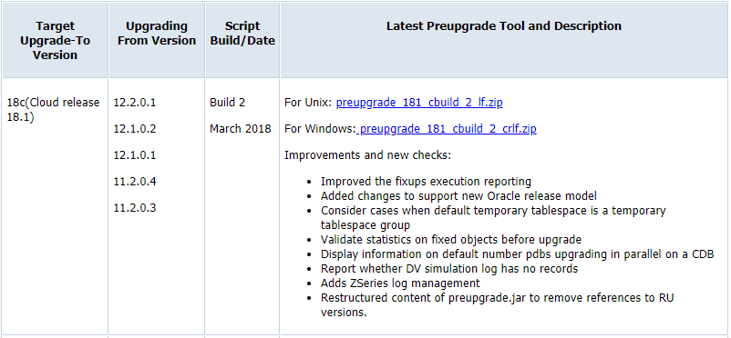
Pre-Upgrade Utility

Slide 10
Pre-Upgrade Utility
How to Download and Run Oracle's Database Pre-Upgrade Utility (Doc ID 884522.1)

Slide 11
SQLPLUS New Options

Slide 12
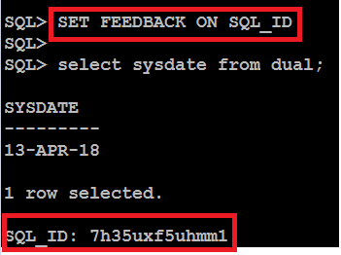
18c SQLPLUS New Options
SET FEEDBACK ON SQL_ID
You can find the sql_id for the executed statement in the sqlplus without querying v$sql or dbms_xplan.display_cursor.

Slide 13
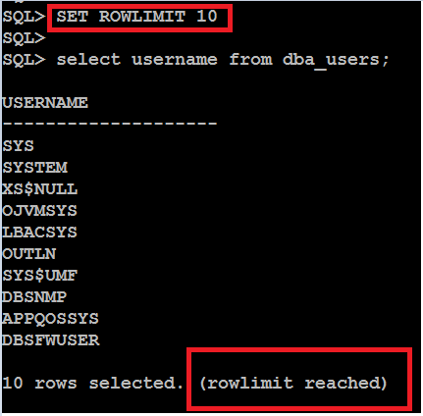
18c SQLPLUS New Options
SET ROWLIMIT n
Limit the Number of rows in the sql prompt, without using rownum

Slide 14
18c Read only Home and Password File Location Changes

Slide 15
Read only Home and Password File Location Changes
Readonly Oracle Home:
[oracle@db18c-se-si bin]$ ./roohctl -enable Enabling Read-Only Oracle home. Cannot enable Read-Only Oracle home in a configured Oracle home. The Oracle Home is configured with databases 'orcl'. The Oracle Home is configured with listeners 'LISTENER'.
We need to comment out /etc/oratab and rename listener.ora file.
[oracle@db18c-se-si bin]$ ./roohctl -enable Enabling Read-Only Oracle home. Update orabasetab file to enable Read-Only Oracle home. Orabasetab file has been updated successfully. Create bootstrap directories for Read-Only Oracle home. Bootstrap directories have been created successfully. Bootstrap files have been processed successfully. Read-Only Oracle home has been enabled successfully.

Slide 16
Read only Home and Password File Location Changes
Disabled back
[oracle@db18c-se-si bin]$ ./roohctl -disable Disabling Read-Only Oracle home. Update orabasetab file to disable Read-Only Oracle home. Orabasetab file has been updated successfully. Read-Only Oracle home has been disabled successfully.

Slide 17
Installing Oracle Database Using RPM Packages in Oracle 18c

Slide 18
Installing Oracle Database Using RPM Packages in Oracle 18c
RPM-based Oracle Database installation is supported only on Oracle Linux systems.
Log in as root
Install the Oracle Preinstallation RPM to prepare your Oracle Linux machine for the RPM-based Oracle Database installation.
# yum -y install oracle-database-server-18c-preinstall
Access the software download page for Oracle Database RPM-based installation from OTN.
Download the .rpm file required for performing an RPM-based installation to a directory of your choice. For example, download the oracle-ee-db-18.1.0.0.0-1.x86_64.rpm file to the /tmpdirectory.

Slide 19
Installing Oracle Database Using RPM Packages in Oracle 18c
Ensure that the /opt directory is owned by the user oracle and group oinstall.
ls -l /opt
# chown -R oracle:oinstall /opt
Go to the rpm directory and run the rpm -ivh command to perform the RPM-based installation.
# cd /tmp/rpm
# rpm -ivh oracle-ee-db-18.1.0.0.0-1.x86_64.rpm
This command creates the Oracle home at the location /opt/oracle/product/18.0.0.0.0-1/dbhome_1.

Slide 20
Installing Oracle Database Using RPM Packages in Oracle 18c
Create a database by using Oracle Database Configuration Assistant (Oracle DBCA) in silent mode.
/opt/oracle/product/18.1.0.0.0-1/dbhome_1/bin/dbca -silent -createDatabase –help
Creates a non-CDB database by passing command-line arguments to Oracle DBCA:
# su oracle
$ /opt/oracle/product/18.1.0.0.0-1/dbhome_1/bin/dbca -silent -createDatabase -templateName General_Purpose.dbc -gdbname orcl -sid orcl -createListener LISTENER:1521

Slide 21
MEMOPTIMIZE_POOL_SIZE in SGA

Slide 22
MEMOPTIMIZE_POOL_SIZE in SGA
The Memoptimized Rowstore improves the data query performance of applications, such as Internet of Things (IoT), that frequently query tables based on primary key values.
About the Memoptimized Rowstore
The Memoptimized Rowstore provides the capability of fast lookup of data for the tables that are mainly queried based on primary key columns.
Enabling the Memoptimize Pool for a Database
Before high frequency queries can use the Memoptimized Rowstore to improve performance, you must enable the memoptimize pool for the database.
Using Fast Lookup
Fast lookup feature of the Memoptimized Rowstore improves the performance of queries that are based on primary key columns.

Slide 23
MEMOPTIMIZE_POOL_SIZE in SGA
The following are considerations for fast lookup:
Tables enabled for fast lookup cannot be compressed.
Tables enabled for fast lookup must have a primary key constraint enabled.
Prerequisites
The database is open.
The COMPATIBLE initialization parameter is set to 18.0.0 or higher.
The MEMOPTIMIZE_POOL_SIZE initialization parameter is set to 0 (default).
The SGA can contain the In-Memory Column Store (IM column store) or memoptimize pool, both of which are optional. No matter which memory management method you use, size the IM column store with the INMEMORY_SIZE initialization parameter, and the memoptimize pool with the MEMOPTIMIZE_POOL_SIZE initialization parameter. The IM column store size are memoptimize pool are included in the memory target, but are not managed by the automatic resize algorithm.
if you set MEMORY_TARGET to 5 GB and INMEMORY_SIZE to 1 GB, then the overall memory target is 5 GB (not 6 GB), and the INMEMORY_SIZE is always 1 GB.

Slide 24
MEMOPTIMIZE_POOL_SIZE in SGA
Enabling the Memoptimize Pool
SQL> SHOW PARAMETER MEMOPTIMIZE_POOL_SIZE
NAME TYPE VALUE
------------------------------------ ----------- ------------------------------
memoptimize_pool_size big integer 0
SQL> ALTER SYSTEM SET MEMOPTIMIZE_POOL_SIZE=10G SCOPE=SPFILE;
System altered.
SQL> SHUTDOWN IMMEDIATE
SQL> STARTUP
SQL> SHOW PARAMETER MEMOPTIMIZE_POOL_SIZE
NAME TYPE VALUE
------------------------------------ ----------- ------------------------------
memoptimize_pool_size big integer 10G
Note: This parameter is not dynamic and required database restart.

Slide 25
MEMOPTIMIZE_POOL_SIZE in SGA
Enabling a New Table for Fast Lookup
CREATE TABLE test_flookup (id NUMBER(5) PRIMARY KEY,test_col VARCHAR2(15)) MEMOPTIMIZE FOR READ;
Enabling an Existing Table for Fast Lookup
ALTER TABLE sh.sales MEMOPTIMIZE FOR READ;
Populating a Table in the Memoptimize Pool
execute DBMS_MEMOPTIMIZE.POPULATE('OE','ORDERS');
Disabling an Existing Table for Fast Lookup
ALTER TABLE sh.sales NO MEMOPTIMIZE FOR READ;

Slide 26
18c Container Database Architecture

Slide 27
Container Database
RMAN duplicate PDB into existing CDB
Refreshable PDB Switchover
Snapshot Carousel
Enhanced DG Integration
Dynamic Lockdown Profiles
CDB Fleet Management
Copying a PDB in an Oracle Data Guard Environment

Slide 28
Docker Support

Slide 29
Docker Support
Docker is a container management service. The keywords of Docker are develop, ship and run anywhere. The whole idea of Docker is for developers to easily develop applications, ship them into containers which can then be deployed anywhere.
With containers, it becomes easier for teams across different units, such as development, QA and Operations to work seamlessly across applications.
You can deploy Docker containers anywhere, on any physical and virtual machines and even on the cloud.
Since Docker containers are pretty lightweight, they are very easily scalable.

Slide 30
Docker Support
Oracle Database is fully supported on Docker for
Oracle Linux 7
Red Hat Enterprise Linux 7
** Oracle RAC is not supported on Docker “CURRENTLY” but in Oracle 18c Oracle RAC support is coming
MOS Note: Oracle Support for Database Running on Docker (Doc ID 2216342.1)
Oracle 12.2.0.1 & 12.1.0.2 images are available on Oracle Container Registry
https://container-registry.oracle.com
Docker build files also available at
https://github.com/oracle/docker-images

Slide 31
THANK YOU

